Slide 1
Parallel Task in C#

Slide 2
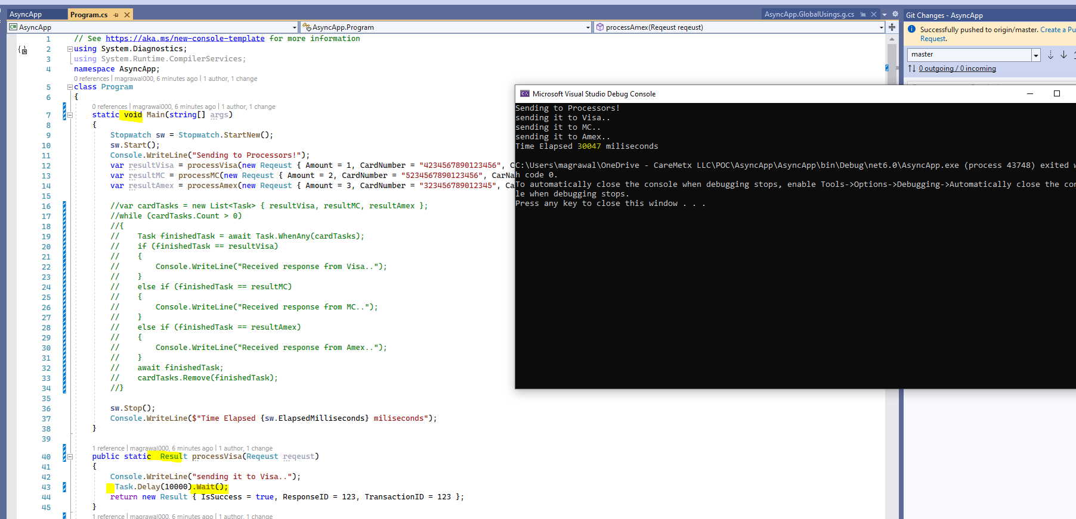
Blocking Tasks
Background thread is blocking
Tasks completed in 30 seconds in sequence and background thread is blocking

Slide 3
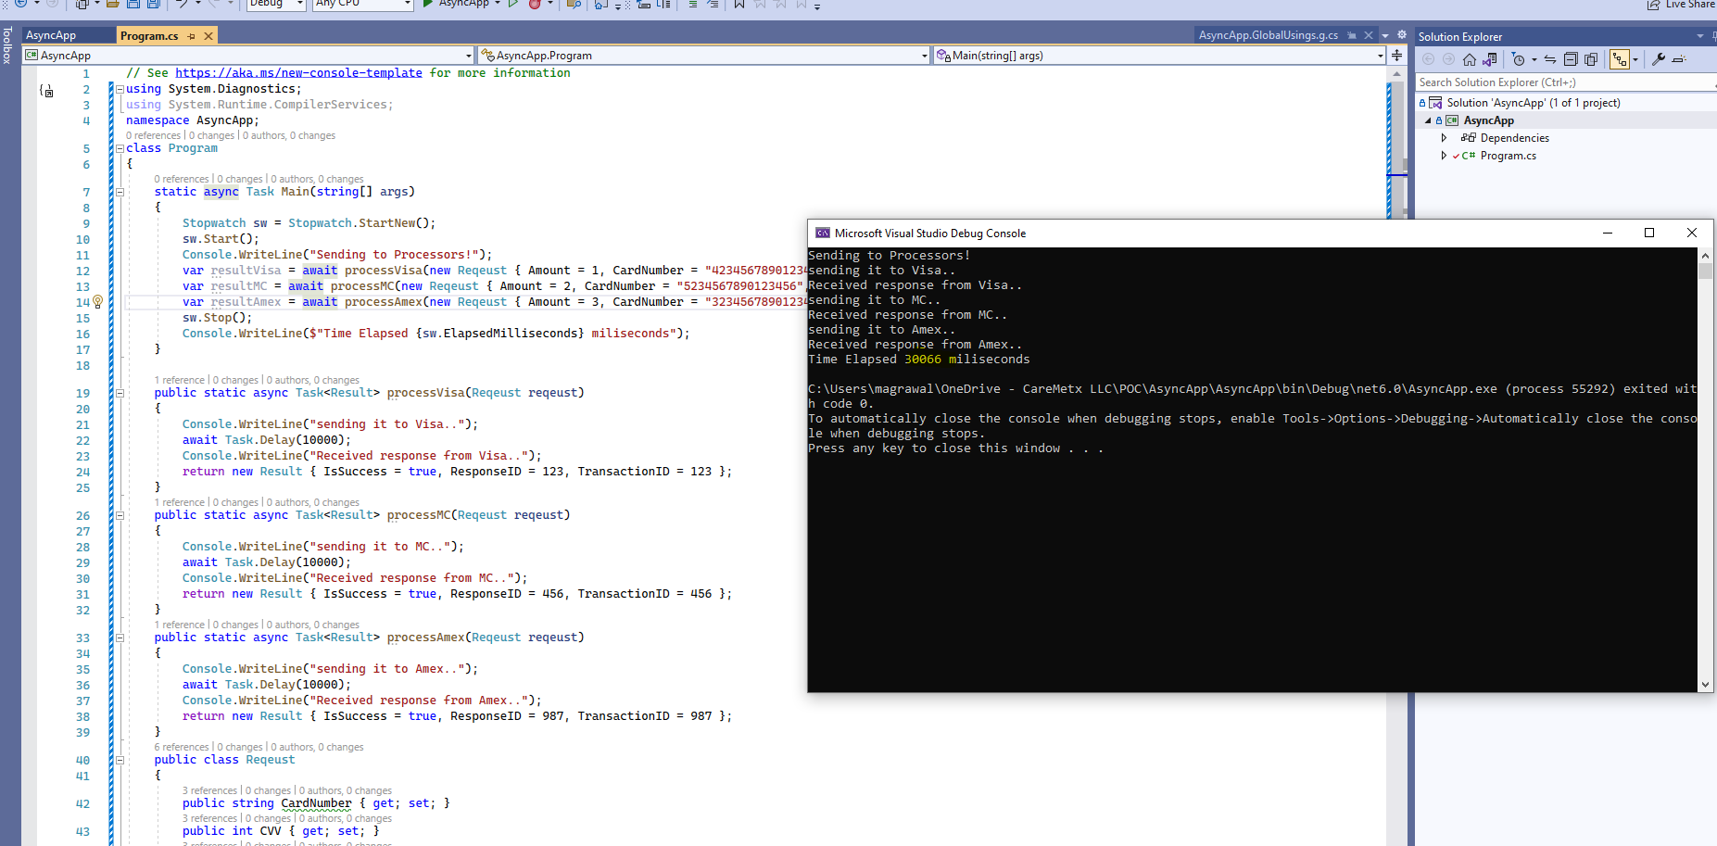
Tasks in sequence
Background thread is not blocking
Still Tasks are in sequence and can wait 30 seconds to complete

Slide 4
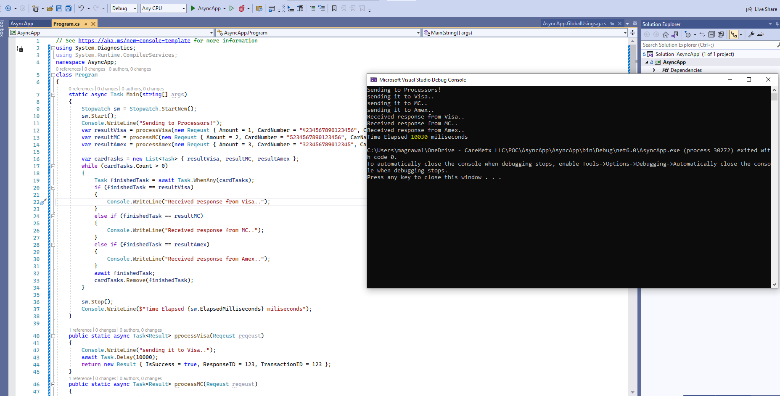
Tasks in parallel
Background thread is not blocking
Tasks completed in 10 seconds as it ran in parallel

Slide 5
Final Code
https://github.com/memukesh/AsyncApp

